Slide 1
Java SE 17 – Presentation
Chapter 6 – Class Design
and
Chapter 7 – Beyond Classes

Slide 2
New things
New keyword for classes
sealed
non-sealed
static
Overloading constructors
Rule: ... must be at the ... line
(code illustration snippet 1)
(code illustration snippet 2)
(code illustration snippet 3)

Slide 3
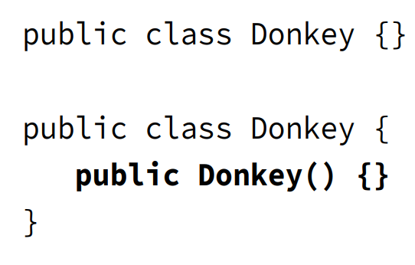
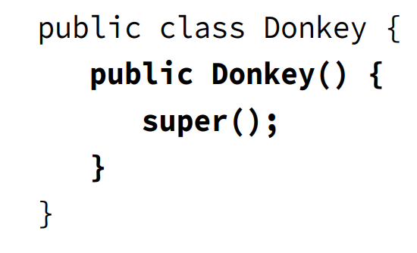
Revision
- Explain these pictures

Slide 4
Revision
(code illustration snippet 4)
Initializing final field
- static final field is ... only ... => It must be ... in the same ...
- However, ... variable is initialized when ... ran => final ... variable will be able to be ... in ..., ... , or ...
(code illustration snippet 5,6)
Order of initializing instances
1:
2:
3:
4:
5:

Slide 5
Revision
- Note: Why can we declare final ... in ... ?
– JLS specifies: final instance variable must be ... and ...
– What does this mean ? This means that the field must be ... on all ... (all ... here means all ...)
- ... means that there must be no ... before ...
HARD RULE: this() ... super() ...
(code illustration snippet 7,8,9,10)
Overriding a method
- Rules when overriding a method
+)
+)
+)
+) (note: This is related to designing programming language => Can't be easily proved)
Note: If super doesn't have ... while sub has ... => ...

Slide 6
Revision
Redeclaring private methods
- Since ... method can't be ... by sub ... => sub... can ...
(code illustration snippet 11)
Hiding static method
- Rules when hiding static method
+) If called using ... name
-) If in ... =>
-) If in ... =>
+) If called using ref ...
-) If both ...
-) If both ...
-) If ...
(code illustration snippet 12)

Slide 7
Revision
Hiding variables
- There are ... cases for variable hiding
+) ... access
-) If both ...
-) If both ...
-) To access super ... uses ..., ... with super ..., ... if static ..., or ref ...
+) Access using ...
-) If ... not =>
-) If ... =>
(note: these cases are applicable for ... variables and without ...)
(code illustration snippet 13)
Creating Abstract classes
- If the ... class doesn't has ... => All ...
(code illustration snippet 14)

Slide 8
Revision
(code illustration snippet 15)
Note: If any classes that ... the class ... => The sub ... will ...
(code illustration snippet 16)
- Note: Static can't ... => can't marked ...
– ... class = first class ...
(code illustration snippet 17)
- Although abstract class can't ... It still can be able to have ...
– However, only ... can call ... thorugh ...
(question 2)
(code illustration snippet 18)
- We can't mix ... and ...

Slide 9
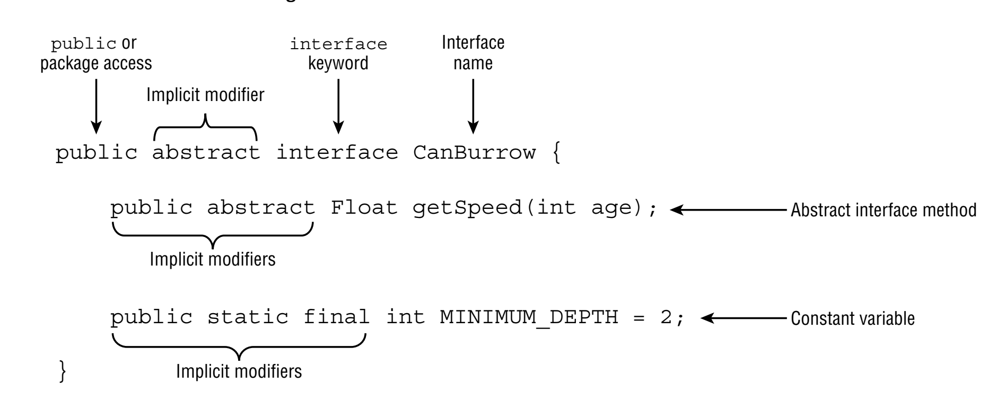
Revision – Chapter 7
Implementing Interface
- Interface can't be ... using ...
- Interface can't be mixed with ... because it is used for ...

Slide 10
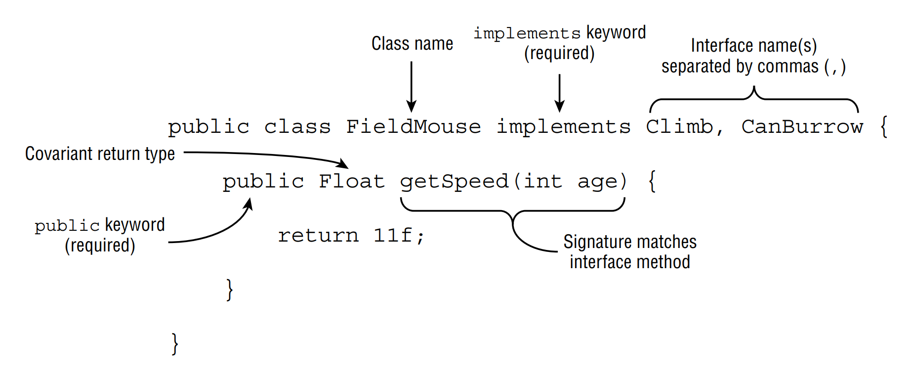




Revision
-
- Interface can ... other ...
(code illustration snippet 19)
- ... is allowed in Interface

Slide 11
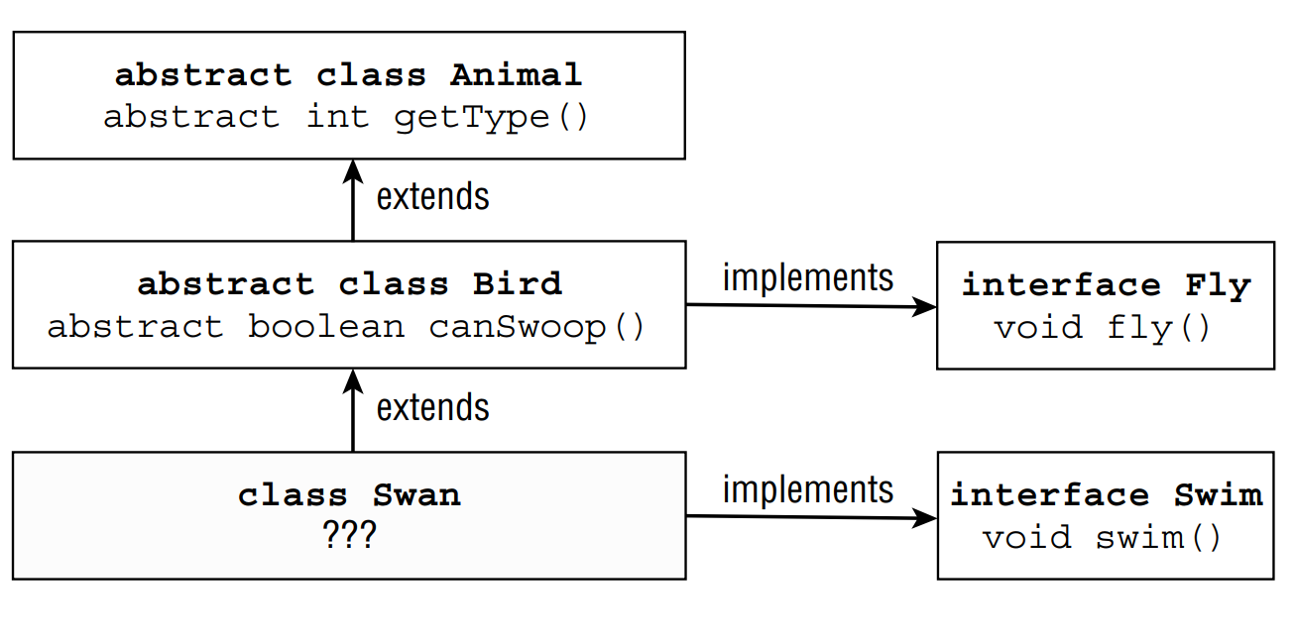

Revision – Chapter 7
-

Slide 12
Revision
Inheriting duplicate abstract method
(code illustration snippet 20)
- In order to do this, 2 methods ... or else ...
(code illustration snippet 21)
- Starting from Java 9, ... is allowed in Interface
– Any other ... aren't allowed

Slide 13
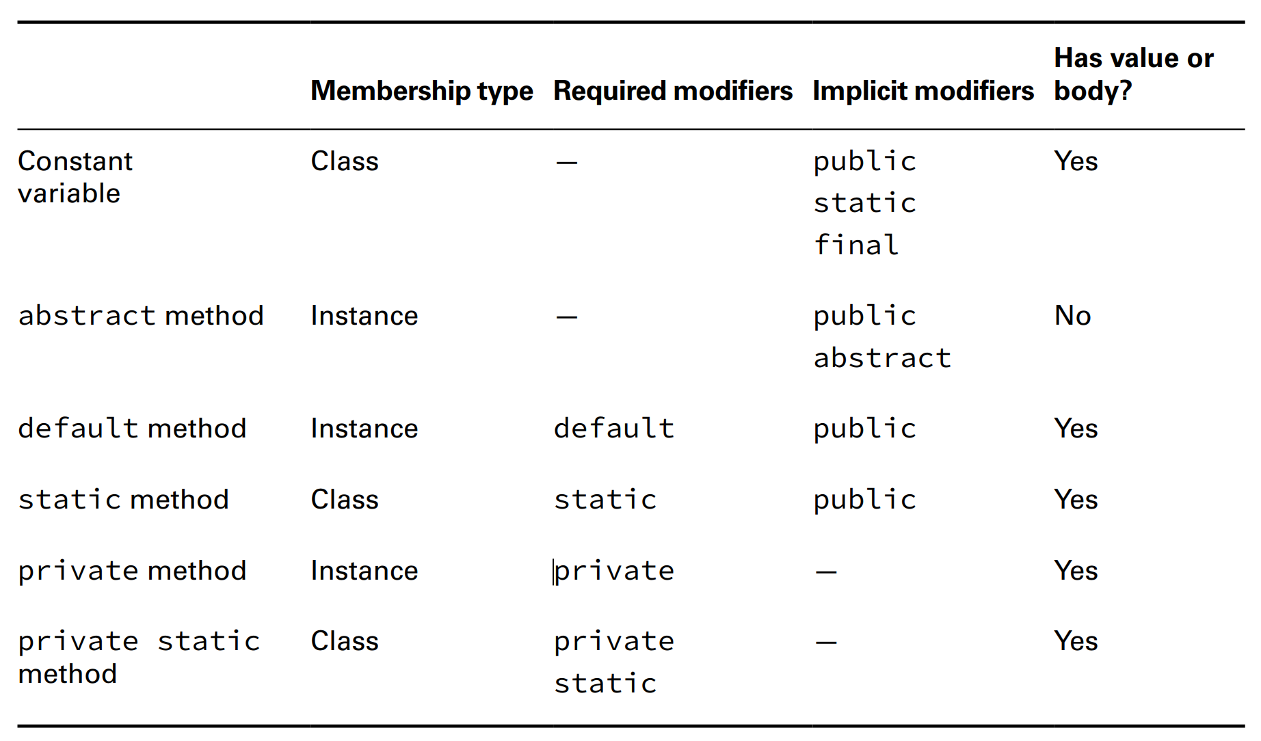
Revision

Slide 14
Revision
- ... modifier can be used for ...
(code illustration snippet 22)
- However, there is a way to ... is ... the method ...
(code illustration snippet 23)
- In order to access ... inside the interface when the method has been ... => We use a special syntax
(code illustration snippet 24)
Reusing code with "private" interface method
- private interface method was created for ...
(code illustration snippet 25)
- Rules when using ...
+)
+)
+)

Slide 15
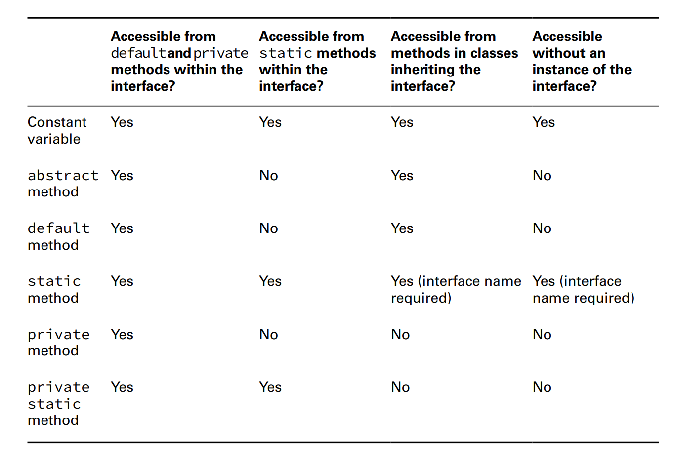
Revision

Slide 16
Revision
Note: To remember things easily, we just need to know that ... method can't be ... inside ...
(code illustration snippet 26)

Slide 17
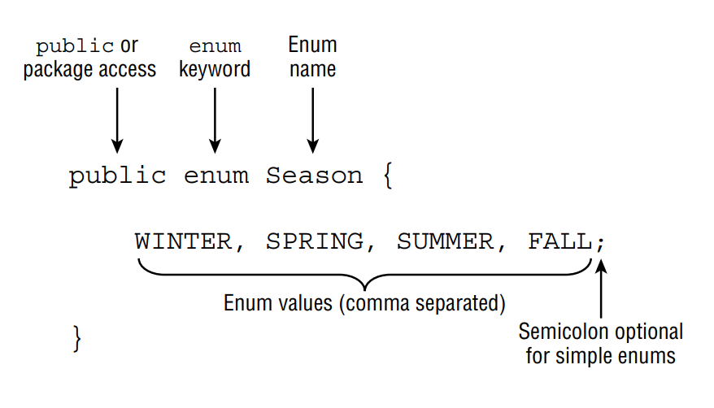


New things
Working with Enum
- In programming, we usually have to ... such as days ....
- Therefore, Java creates Enum – A ... set of ...
– Enum is better than a class ... bunch of ... because Enum has ... mechanism
– For ... and ..., we can pass an invalid ... but with ... this is impossible because it checks at ... time
- We use Enum when we have a ... set of ...

Slide 18
New things
(Note: All enums will ...)
- Since all values in enum are ... we are opted to use ... case
(code illustration snippet 27)
- We can use ... operators with enum since they are all ... => They are ... and ... once in ...
– One thing you can't do is ...
calling the values(), name(), and ordinal() methods
(code illustration snippet 28)
- Technically, Enum values are ... => It can't be ... with ...
(code illustration snippet 29)
valueOf() (question 3)
(code illustration snippet 30)

Slide 19
New things
Using Enums in switch statements
- Enum is the only ...
(code illustration snippet 31)
- We must ... syntax, or else ...
- Also mentioned, enum is ..., therefore, it can't be ....
(code illustration snippet 32)
Adding Constructors, Fields, and Methods
- ... enum, we can also have ... enum
(note: this time, the ... won't be ... anymore but it must be ...)
(code illustration snippet 33)
Note: ... field in enum is recommended ...
- Although we can set ... field to be ..., it is ... recommended since ... JVM (question 3)
- All enum ... private => This is understandable because ... call and enum can't be ...
- All parentheses in ... without the ... keyword. If we use ... for the first ... JVM will ... and after ...
(code illustration snippet 34)

Slide 20
New things
- If the OnlyOne enum has been ... before the ... => It won't
– We can also have different ... for each ...
(code illustration snippet 35)
- The syntax looks like we create ... and ... look like they are ...
- This is actually nearly correct because each ... is a ...
– But if we don't want this, we can ... and each ... or ...
(code illustration snippet 36)
- Enum can also ...
(code illustration snippet 37)
- Just because Enum can has ... doesn't mean it ...
- We must keep ...
- IMPORTANT: The ... first ... in enum

